Slide 1
MULTI-CUT REBAR(12)
Advisor : Prof. K.C.Chang
Presenters : You-Ran Nai
Notes:
試試看暫停一下

Slide 2
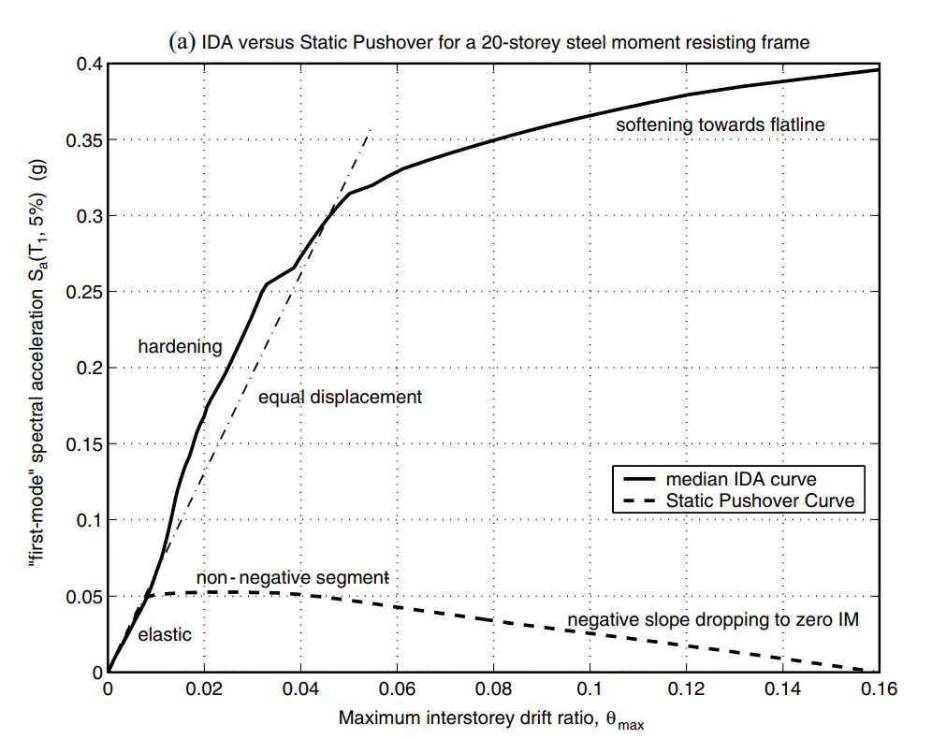
NON-LINEAR SPO
ELASTIC
➔
MATCH
NON-NEGATIVE
➔
EQUAL DISPLACEMENT
NEGATIVE
➔
SOFTENING

Slide 3
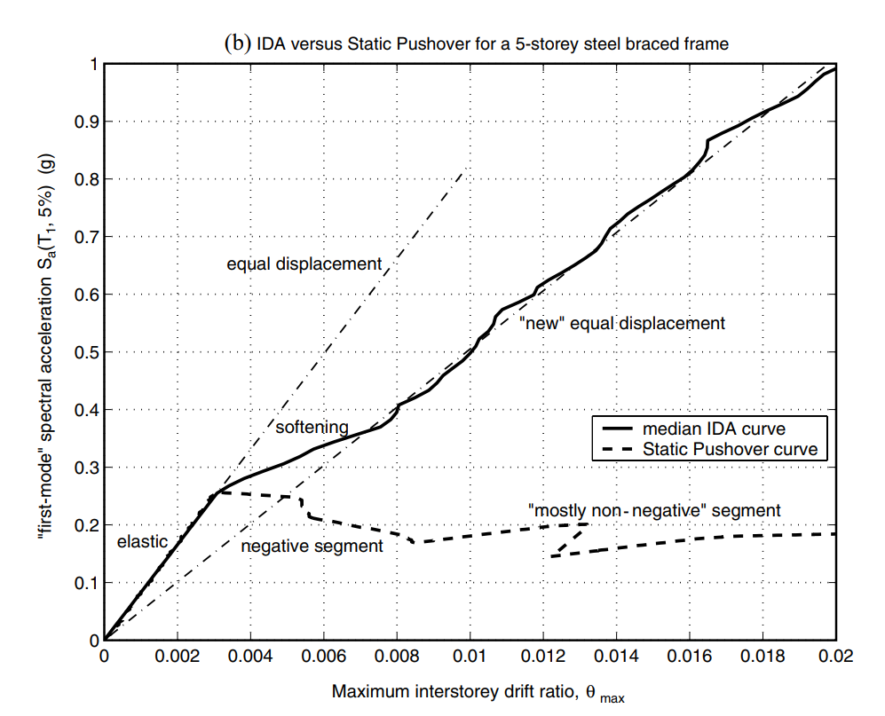
NON-LINEAR SPO
NEGATIVE => NON-NEGATIVE
NEW
EQUAL DISPLACEMENT
➔

Slide 4
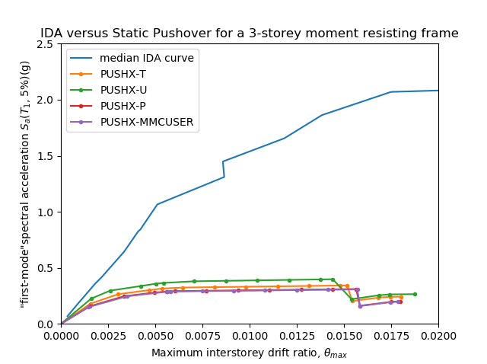
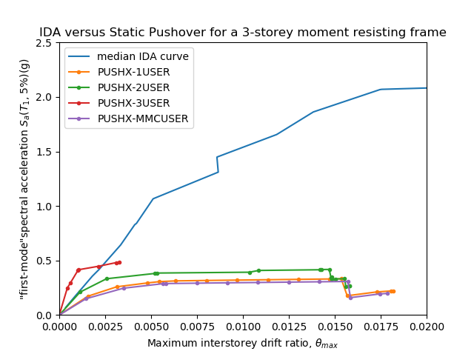
Problem: Pushover too Low

Slide 5
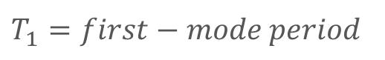
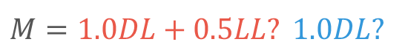
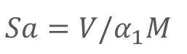
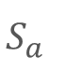
Defined
$$"first-mode"spectral acceleration S_{a}(T_{1}, 5\%)(g)$$
$$S_{a}$$
$T_{1}=first−mode period$
$$Sa=V/α_{1}M$$
$$α_{1}=Modal Mass Coefficient for the First Natural Mode.$$
$$M=1.0DL+0.5LL? 1.0DL?$$

Slide 6
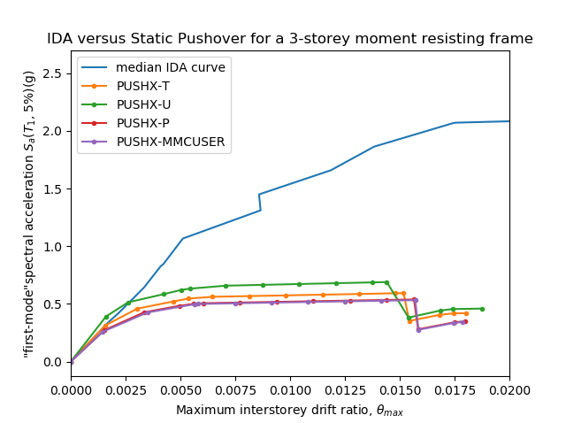
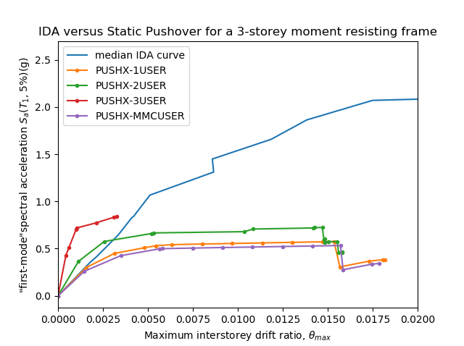
Close, but still have Gap

Slide 7
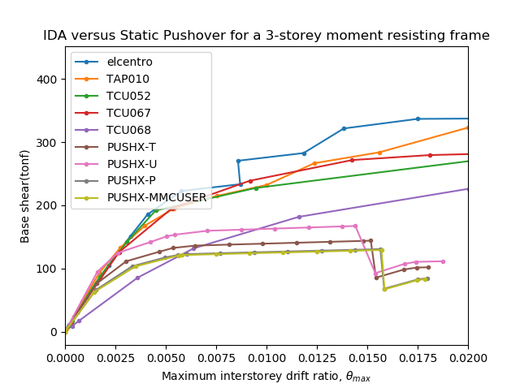
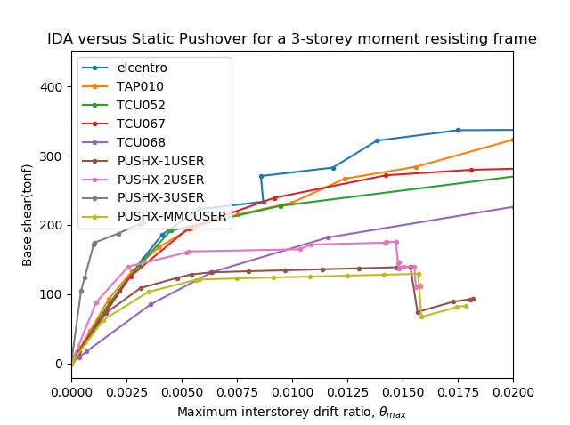
Another way IM: Base Shear

Slide 8
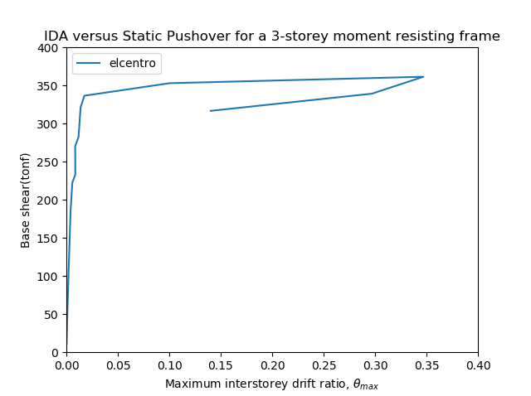
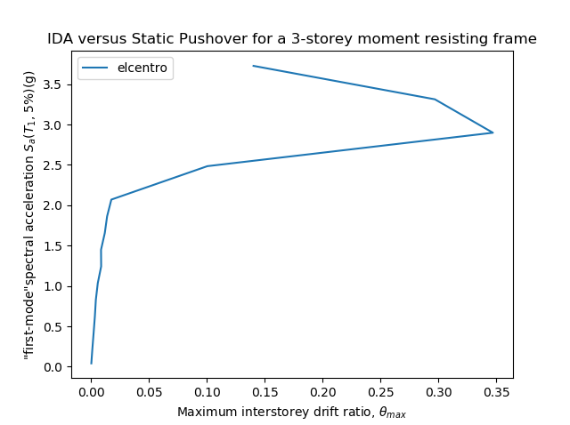
Problem: IM: Base Shear
Scaled Factor
➔
Base Shear
Without Median or Mean Curve
Base Shear May be Damage Measure ( DM )
Scale Bigger than Former
Notes:
Don’t have median curve, because IM 不唯一

Slide 9
FEMA
Linear Static Procedure
Linear Dynamic Procedure
Nonlinear Static Procedure
Nonlinear Dynamic Procedure
In Design and Maximum Earthquake

Slide 10
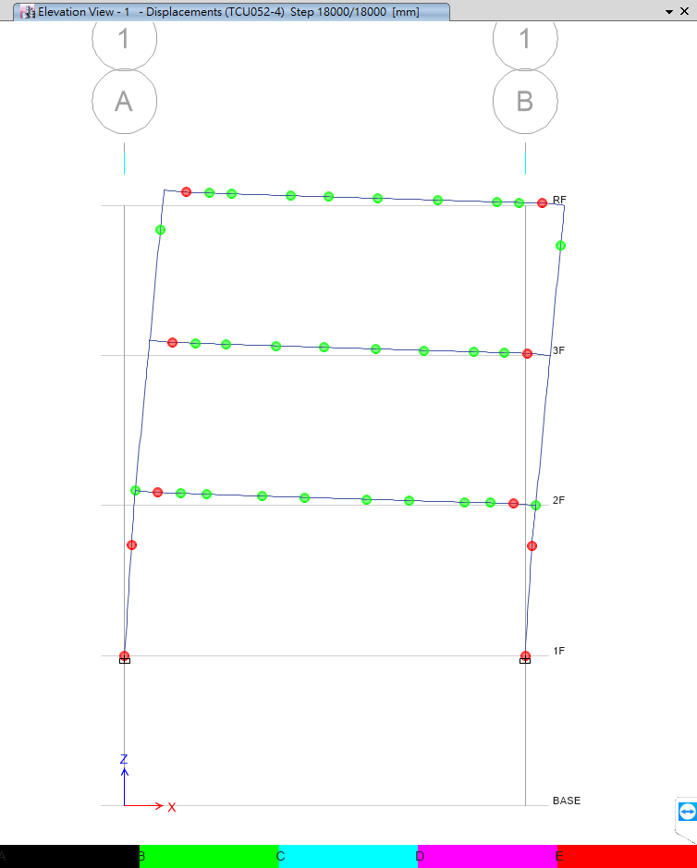
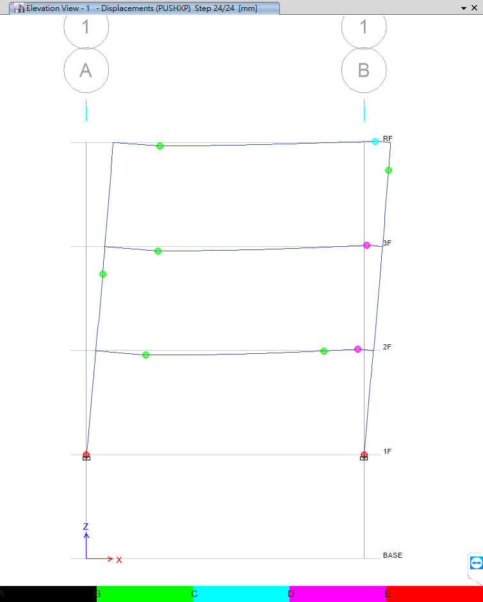
Problem: Without Middle Hinge
Time History
Pushover
No Middle Hinge

Slide 11
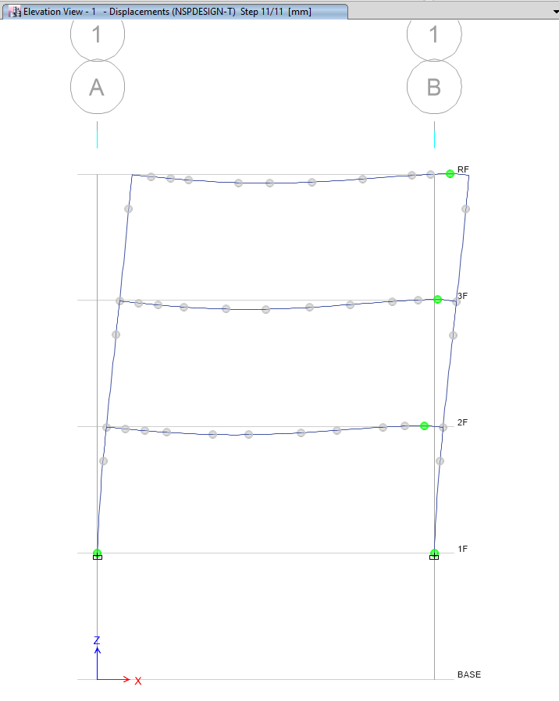
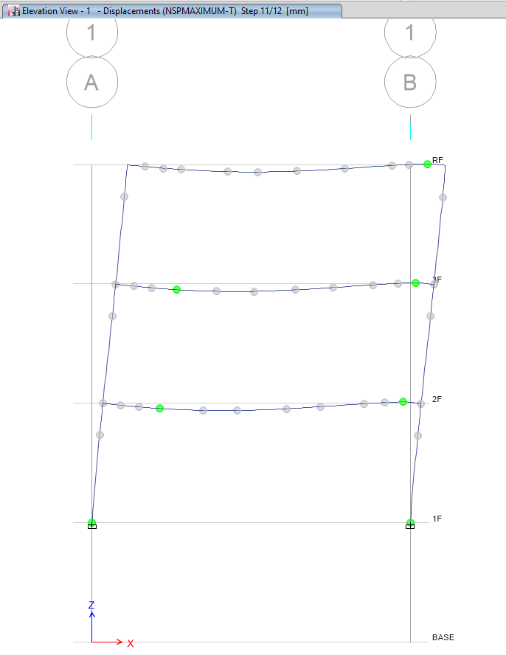
FEMA: NSP
Design
Maximum

Slide 12
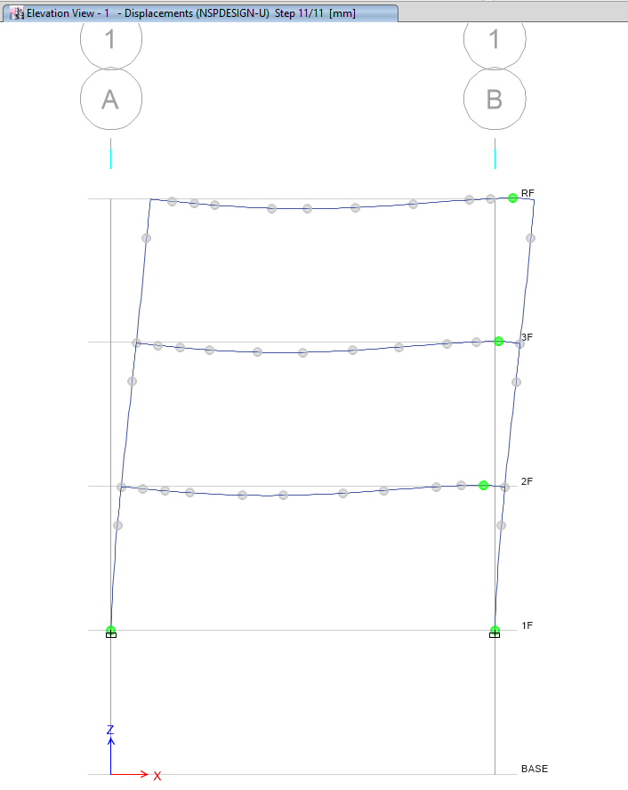
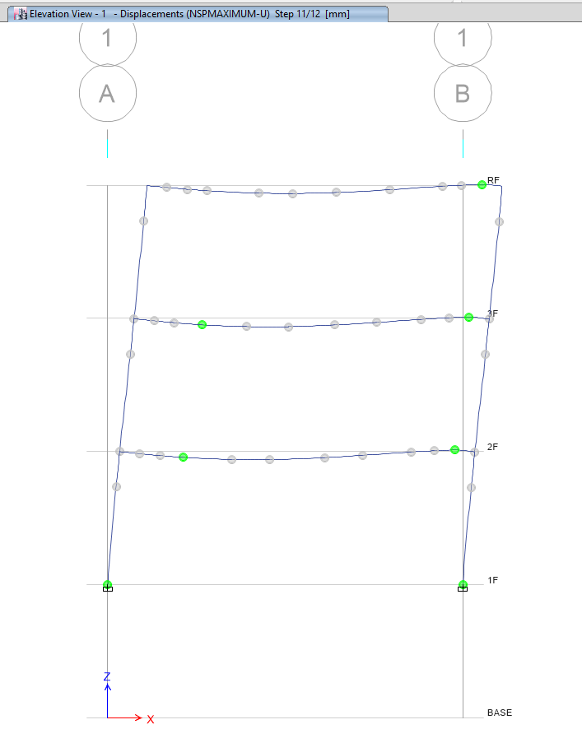

Slide 13
Artificial Time History - TAP010
Design Spectrum
Maximum Spectrum

Slide 14
TAP032

Slide 15
TAP052

Slide 16
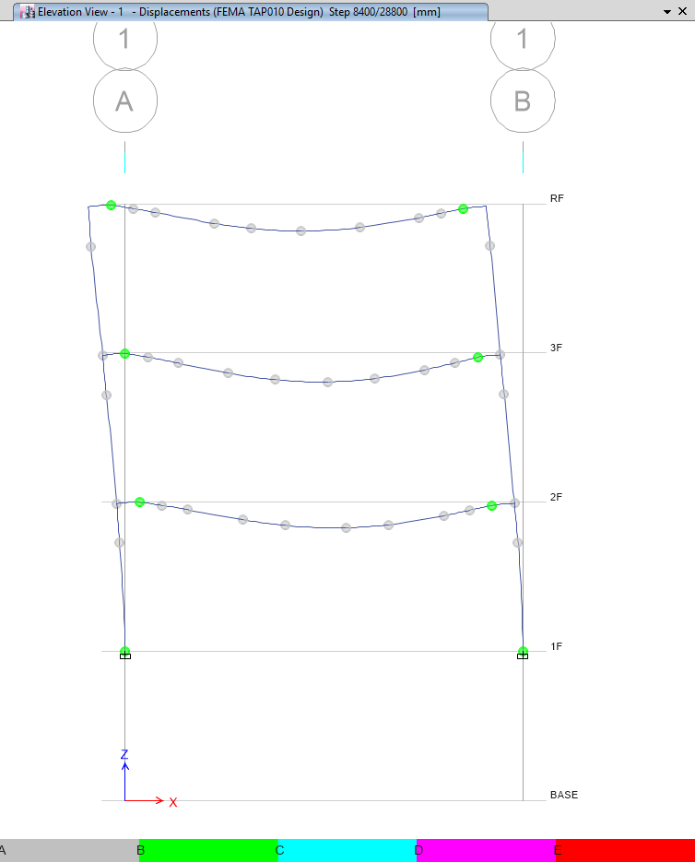
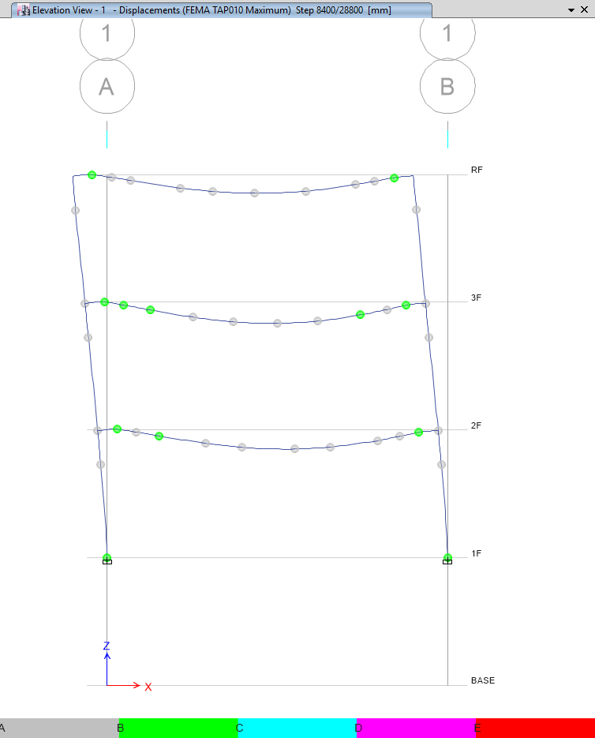
Artificial Time History - TAP010
Design
Maximum

Slide 17
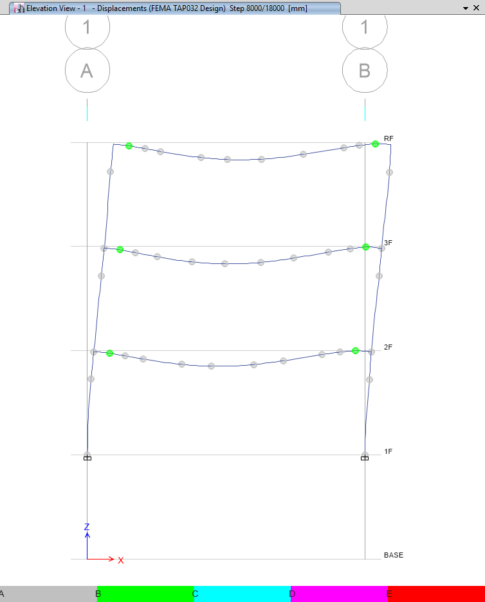
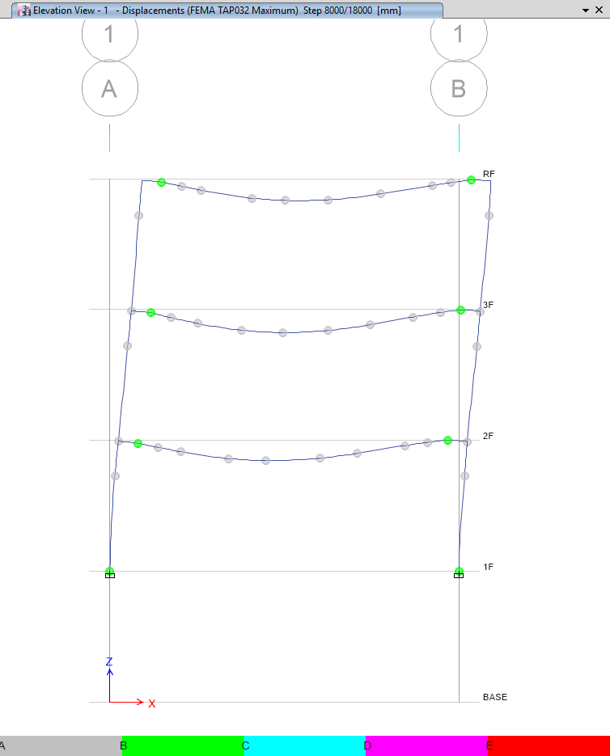

Slide 18
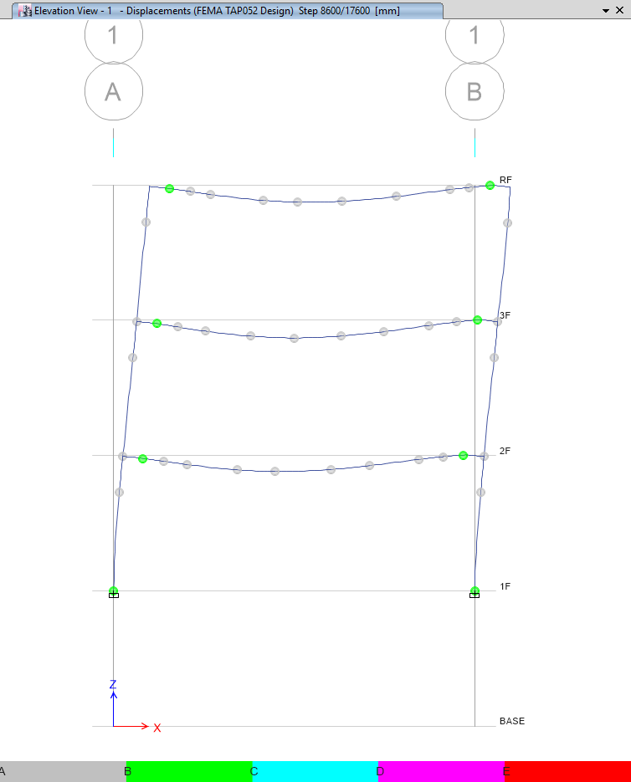
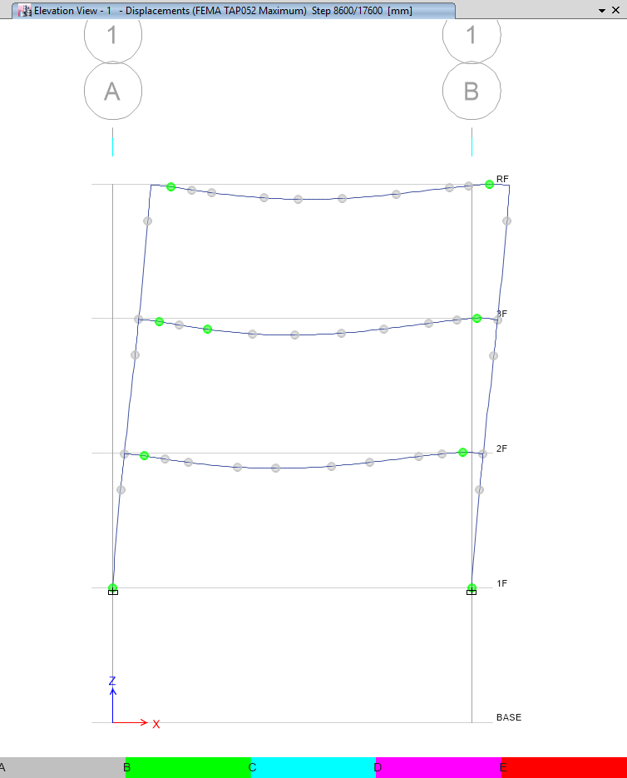

Slide 19
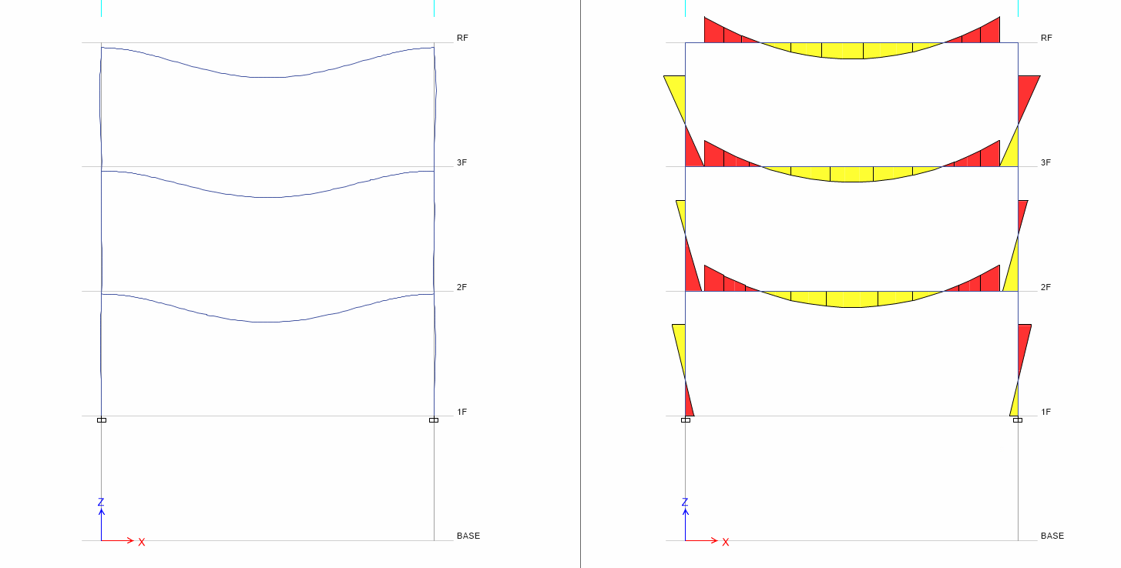
Pushover 0 Step
Hinge
Moment

Slide 20
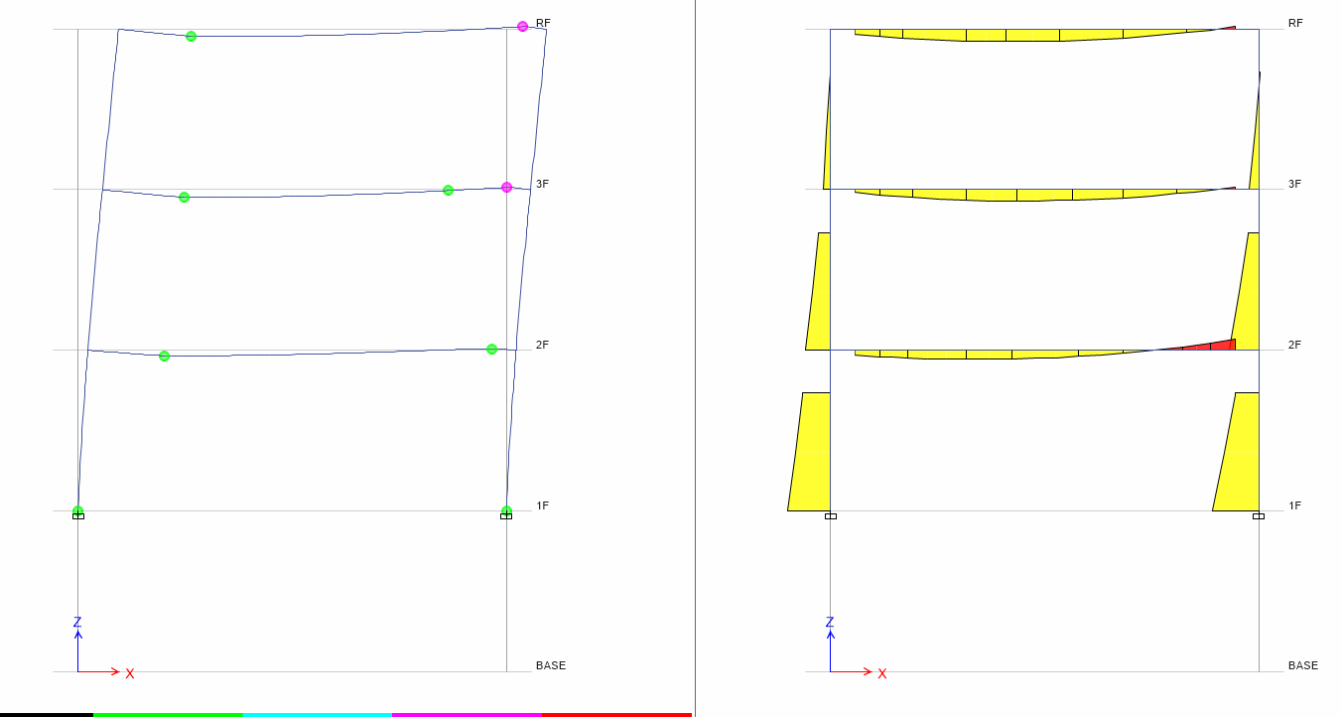
Pushover 13 Step
Hinge
Moment

Slide 21
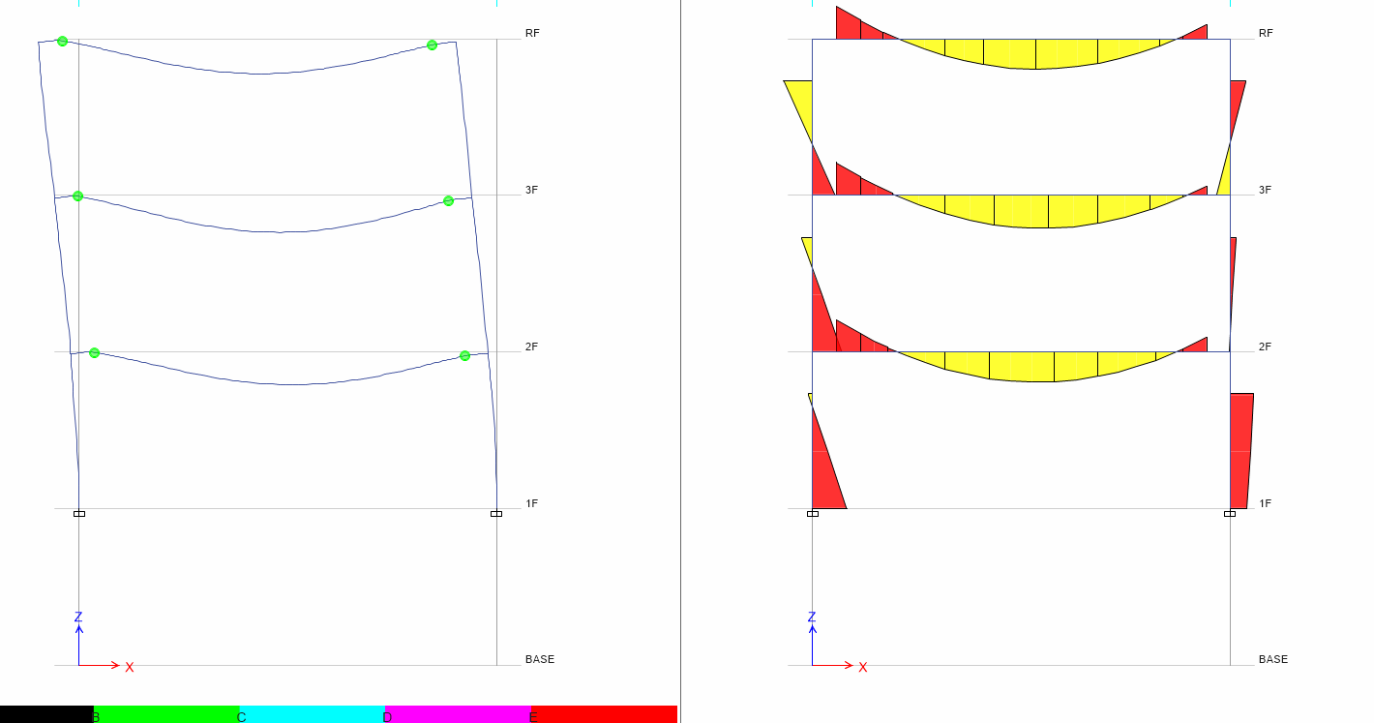
Time History 30s
Hinge
Moment

Slide 22
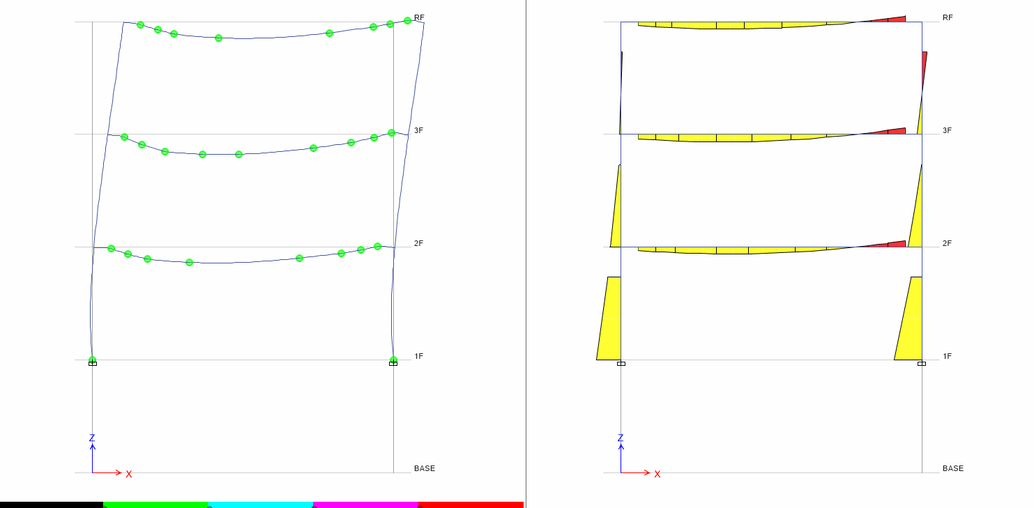
Time History 40s
Hinge
Moment

Slide 23
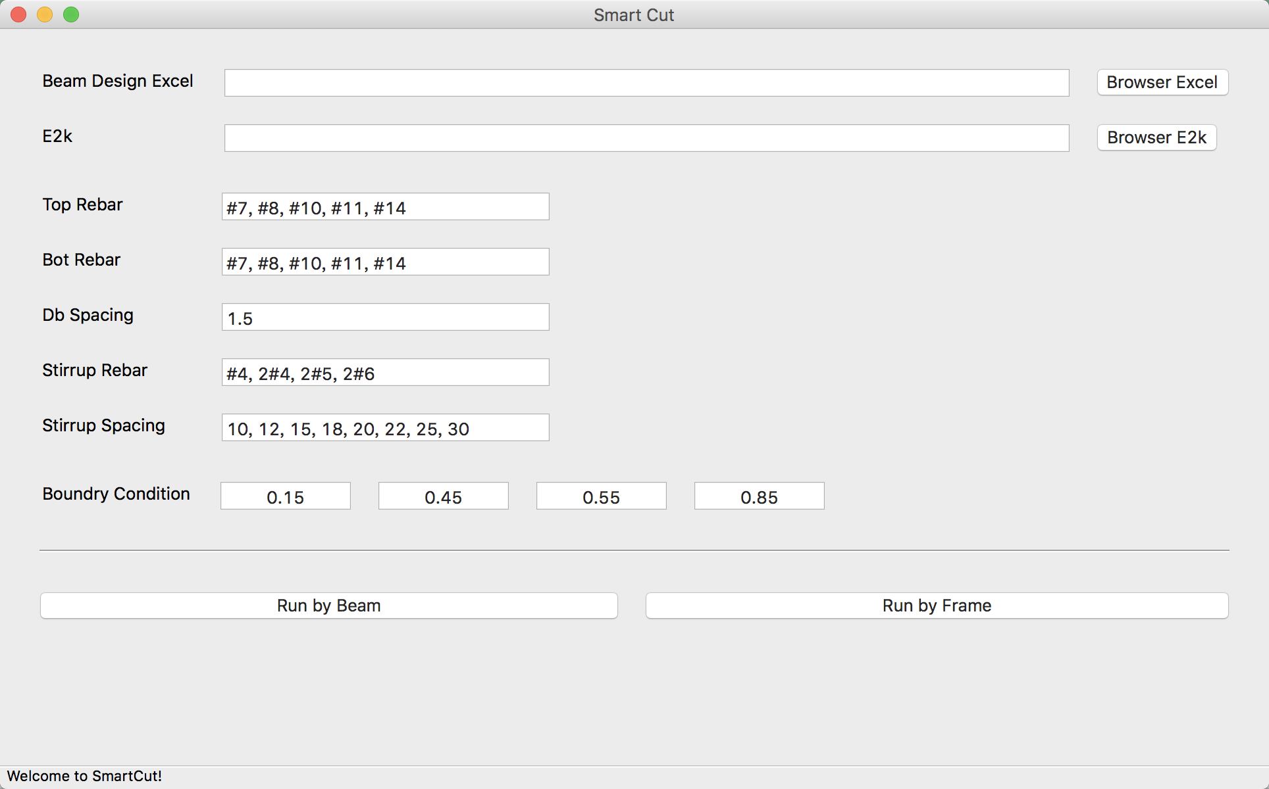
LinearCut
GUI

Slide 24
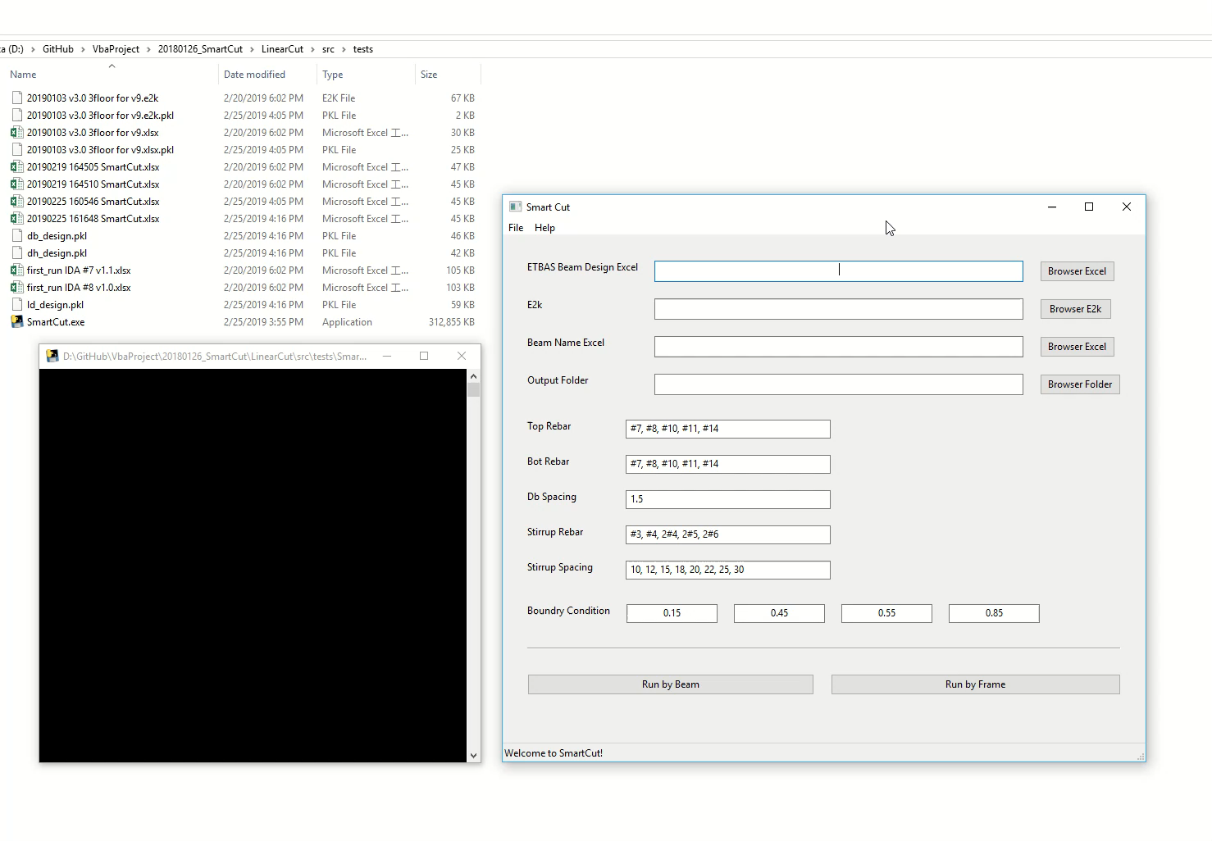

Slide 25
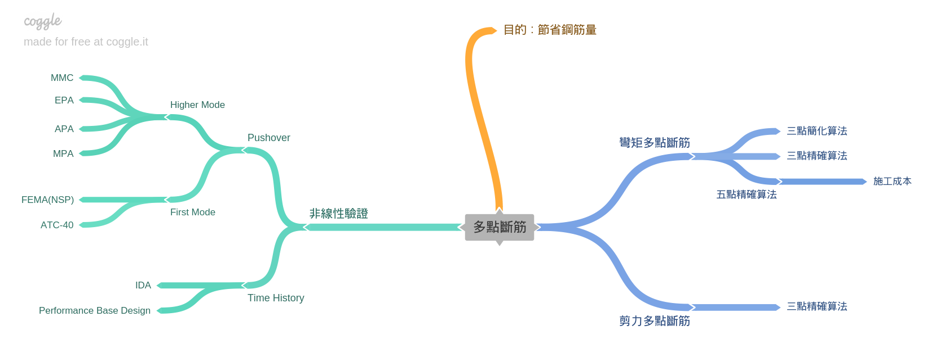
Roadmap
Nonlinear Hinge

Slide 26
Roadmap
Nonlinear Hinge Program: To Use In Complex Structure
FEMA: To Verify IDA Result is Correct
Simulate Model: 2-D 3 story ➔ FEMA P695 Model? ➔ Actual Model ( from corporation )

